Slide 1

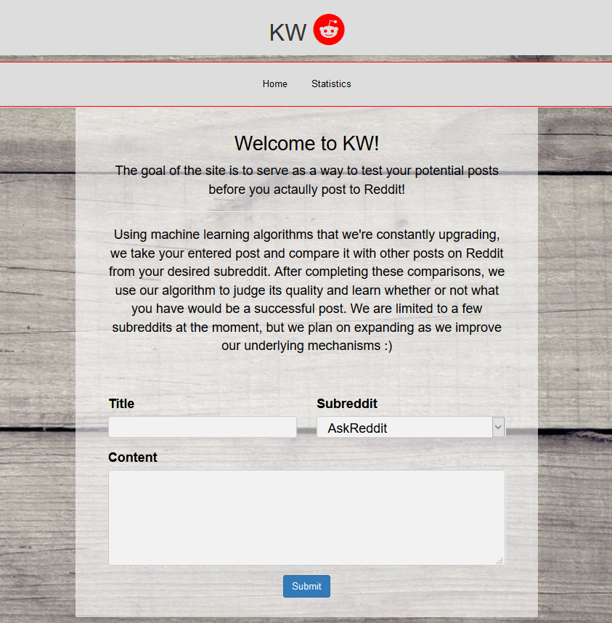
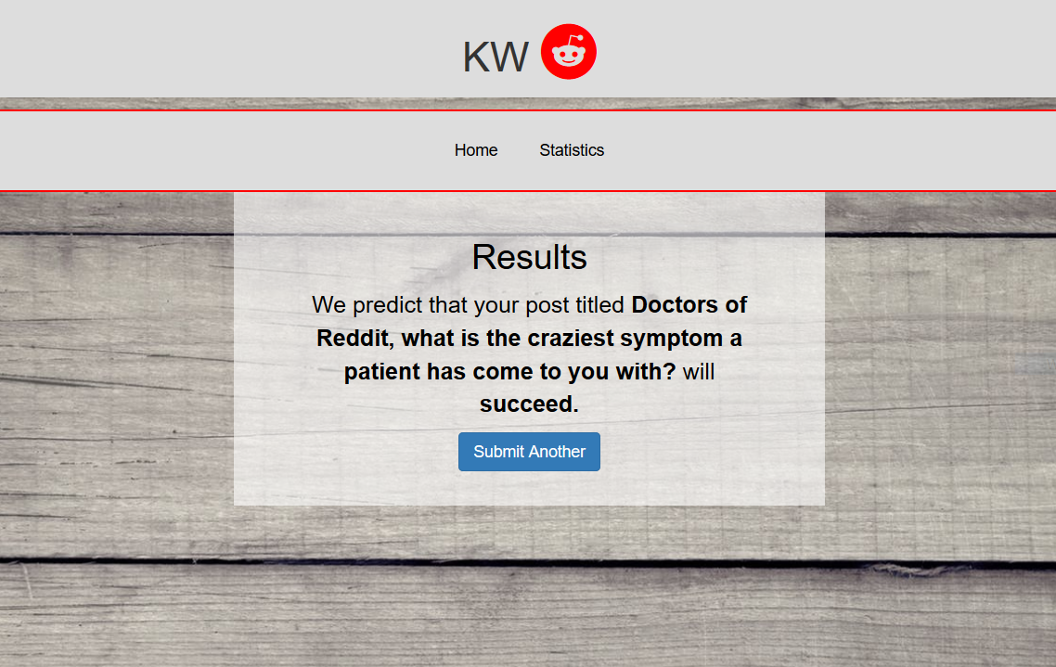
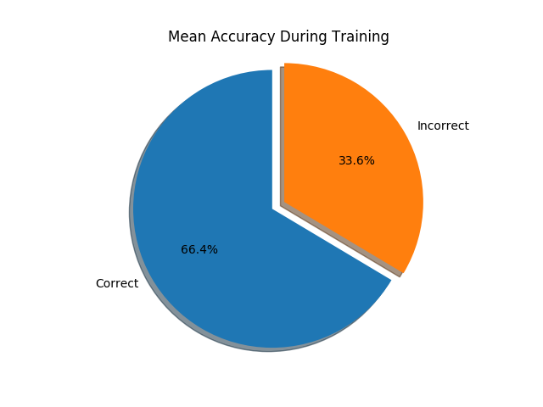

KW
Approaching Text Based Subreddits Through Machine Learning
Hagan Brewer, Joshua Brucker, Solomon Kim, Nelson Vargas
Abstract: A large part of Reddit's success as a "social news aggregation, web content rating, and discussion website" should be accredited to the implementation of karma as a powerful reward system that users can use to control what content is seen. Posts and inevitably users that gain a large number of upvotes (a high karma score) are viewed with greater frequency and in higher regard respectively. Our team sought to build a machine learning system that attempts to classify whether a new Reddit post will be popular in a respective subreddit. With this, users can get a feel as to whether or not they should make their posts public.
Figure 1: Home Page
Approach: Using a combination of naïve Bayes and logistic regression models, in combination with lots of data, our algorithm analyzes the highest and lowest rated posts over the last two years of Reddit post history. The algorithm then runs the user’s input through our models and predicts whether or not it is likely to be successful on a subreddit. “Success” is determined by a karma threshold defined by us per subreddit.
Figure 2: Results Page
Technologies:
Python
Bootstrap/HTML/CSS
Flask
ML/Scikit-learn
Features:
Title analysis
Access to complete Reddit archive
Fast results
Conclusion/Findings: Through this assignment, our team had the opportunity to delve into a realistic development setting. We faced many real-world challenges such as learning new technologies, connecting technologies, and falling into technical debt. While we were able to learn a lot of the impressive hands-on capabilities of machine learning, we were also given the opportunity to experience and prepare for what life as a developer outside of college might truly be like.
Figure 3: r/AskReddit Post Accuracy
Future Work: We would like to expand our machine learning algorithms to include images from visual subreddits such as r/Pics.
Visit our repo by scanning the QR code ->
We would like to acknowledge the following people/groups for their help: Dr. Benjamin Mitchell, Jason Dobies, the Villanova Computer Science Department.

